Slide 1
Deep Reinforcement Learning for Unsupervised Video Summarization
with Diversity-Representativeness Reward

Slide 2
Table of contents
01
02
03
04
Introduction
Proposed Method
Experiment
Demo

Slide 3
01
Introduction

Slide 4

Introduction
Are you overwhelmed by the massive amount of videos online?

Slide 5
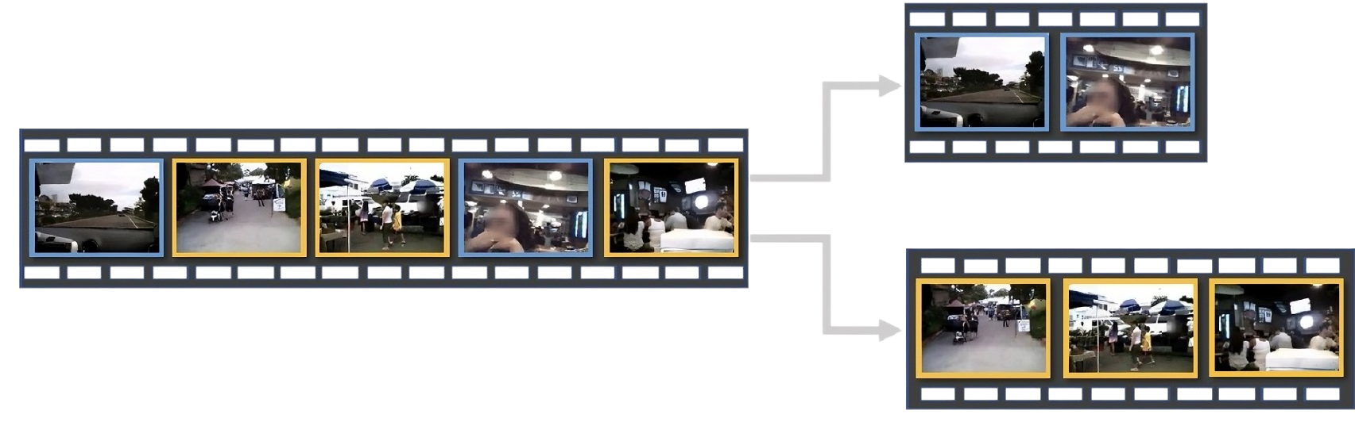
Introduction
Video summarization is a technique that creates a concise summary that captures the key information from the original video.
Notes:
What is summarization?
Turn original video to shorter version which still keep primary information

Slide 6
Introduction
Why do we need a tool like this ?
Benefit
Enhanced Content Discovery and Browsing
Time-Saving and Efficiency
Application:
Thumbnail Youtube
Notes:
Đưa ra quyết định nhanh hơn: Bản tóm tắt cho phép chúng tôi nhanh chóng quyết định xem một video có đáng để chúng tôi dành thời gian và sự chú ý hay không, giúp đưa ra quyết định nhanh hơn trong việc chọn nội dung sẽ xem.
Hiệu quả về thời gian: Với lượng nội dung video khổng lồ có sẵn, phần tóm tắt giúp người dùng nhanh chóng hiểu được bản chất mà không cần xem hết video, tiết kiệm thời gian.

Slide 7
Introduction
Challenges with supervised learning for video summarization:
Relies heavily on labeled data
Limited scalability
Subjectivity bias

Slide 8
Introduction
Researchers are exploring innovative approaches to address these challenges, including:
Eliminates the need for labeled data
It is more scalable and adaptable to diverse video content.
Creating high-quality summaries on both diversity and representativeness aspects
Notes:
Tại sao phương pháp này là mới mẻ?
Hoàn toàn không cần giám sát: Loại bỏ nhu cầu về dữ liệu được gán nhãn bởi con người, vốn đắt đỏ và có thể mang tính thiên vị.
Không phụ thuộc vào dữ liệu có gán nhãn: Giúp phương pháp này mở rộng quy mô và thích ứng tốt hơn với các nội dung video đa dạng.
Tạo ra các tóm tắt chất lượng cao: Đảm bảo cả tính đa dạng và tính đại diện trong các tóm tắt.

Slide 9
02
Proposed Method

Slide 10
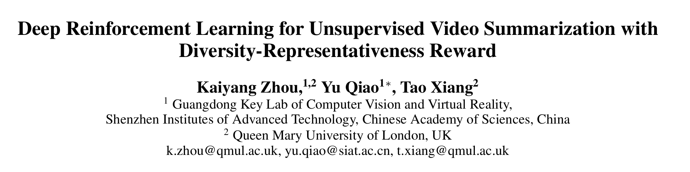
Overview
Following the Paper: ”Deep Reinforcement Learning for Unsupervised Video Summarization with Diversity-Representativeness Reward” (Kaiyang Zhou, Yu Qiao and Tao Xiang, 2018).

Slide 11
Key Words
Sequential decision making process
Deep Summarization Network - DSN
Frame -> Selected Frame
End-to-end reinforcement learning framework
Diversity-Representativeness Reward Function

Slide 12
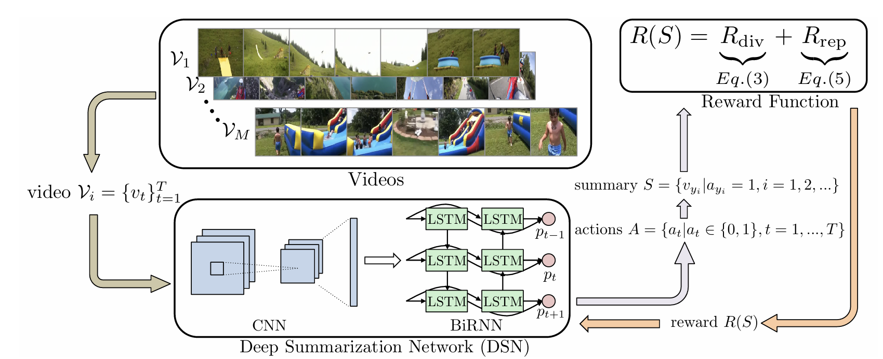
Overall learning process

Slide 13
Overall learning process

Slide 14
Overall learning process

Slide 15
Overall learning process

Slide 16
Overall learning process

Slide 17
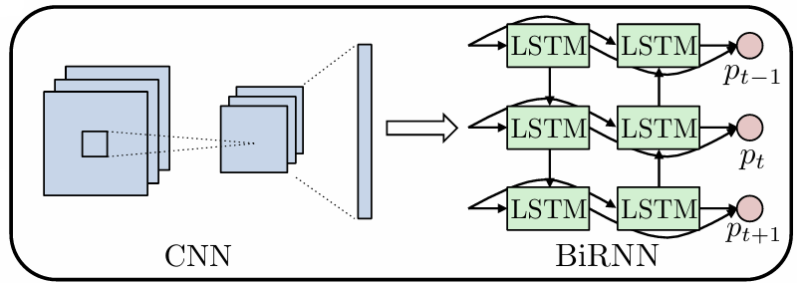
Deep Summarization Network (DSN)
DSN Encoder-Decoder Framework

Slide 18
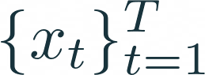
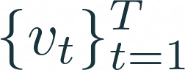
Deep Summarization Network (DSN)
A convolutional neural network (CNN) that extracts visual features from the input video frames with the length T.
The GoogLeNet (Szegedy et al. 2015) pretrained on ImageNet was used as DSN Encoder.
DSN Encoder-Decoder Framework
Feature extractor

Slide 19
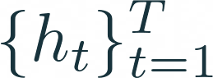

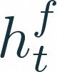
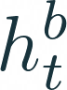
Deep Summarization Network (DSN)
A bidirectional recurrent neural network (BiRNN) with a fully connected (FC) layer.
BiRNN takes as input the entire visual features cccccc and produces corresponding hidden states .
DSN Encoder-Decoder Framework
Each is the concatenation of and .
=> Encapsulate the future information and the past information with a strong emphasis on the parts surrounding the t ^{th} frame.

Slide 20


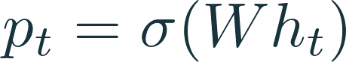

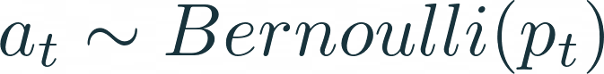

Frame Selection Mechanism
The FC layer that ends with the sigmoid function predicts for each frame a probability , from
which a frame-selection action is sampled.
The probability is calculated as:
The action indicates whether the t ^{th} frame is selected or not, follows a Bernoulli distribution:
Notes:
Bữa thầy nói phân phối xác suất Bernouli cho 2 xác suất thành công/thất bại hay lấy frame/bỏ frame

Slide 21
Frame Selection Mechanism
A video summary is composed of the selected frames:
Note:
The bias in (1) is omitted for brevity.
During training, only update the decoder.

Slide 22


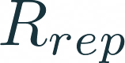
Diversity-Representativeness Reward Function
During training, DSN will receive a reward , which assesses the quality of the generated summary based on diversity and representativeness.
In general, a high-quality video summary is expected to be both diverse and representative of the original video.
=> A novel reward was proposed, composing of a diversity reward and a representativeness reward .

Slide 23
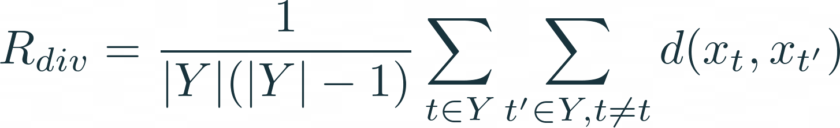

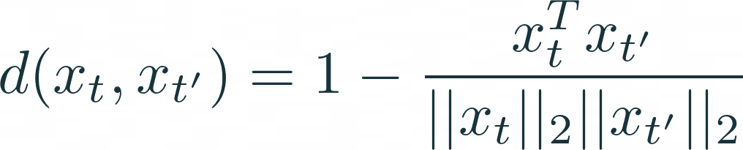

Diversity Reward ( )
Measures the dissimilarity among the selected frames in the feature space.
Therefore, is computed as the average pairwise dissimilarity between all the selected frames in the summary.
where d(. , . ) is the dissimilarity function calculated by:
Notes:
Bữa thầy nói phân phối xác suất Bernouli cho 2 xác suất thành công/thất bại hay lấy frame/bỏ frame

Slide 24
Intuitively, the more diverse (or more dissimilar) the selected frames to each other, the higher the diversity reward that the agent can receive.

Slide 25
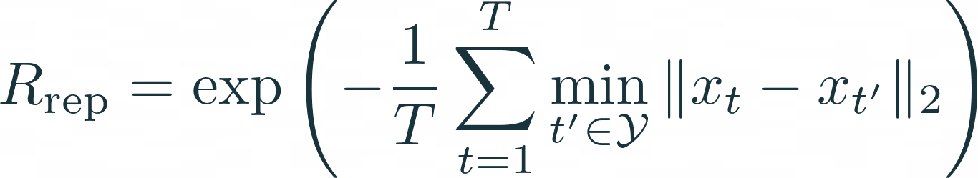

Representativeness Reward ( )
Measures how well the selected frames represent the original video.
The degree of representativeness of a video summary is formulated as the k-medoids problem.
The goal is to select a set of medoid (center) frames so that the mean of squared errors between video frames and their nearest medoid is minimal.
Notes:
Bữa thầy nói phân phối xác suất Bernouli cho 2 xác suất thành công/thất bại hay lấy frame/bỏ frame

Slide 26
Representativeness Reward ( )
With this reward, the agent is encouraged to select frames that are close to the cluster centers in the feature space.
=> By doing this, the system ensures the chosen frames effectively capture the core visual content of different parts of the original video.
E.g: if a cluster contains frames with a lot of fast motion, a frame that also has a lot of motion to represent that part of the video.

Slide 27
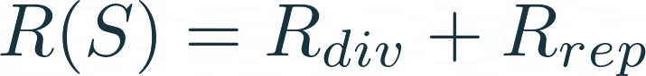

Diversity-Representativeness Reward
The overall reward is a combination of diversity and representativeness rewards.
Note:
It is important to keep and at the same order of magnitude during training, so that neither of them would dominate in gradient computation.
DSN is given zero reward when no frames are selected.

Slide 28


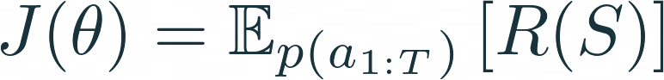

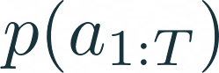
Training with Policy Gradient
The agent's goal is to learn a policy function with parameters by maximizing the expected
rewards.
Note:
: the probability distributions over possible action sequences.
ccccc: Diversity - representativeness reward.
is defined by DSN.

Slide 29
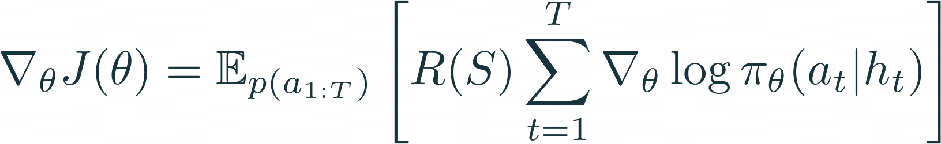

Training with Policy Gradient
Following the REINFORCE algorithm:
Note:
at is the action taken by DSN at time t.
Ht is the hidden state from the BiRNN.

Slide 30
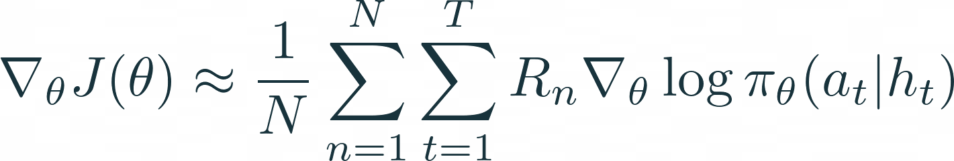


Training with Policy Gradient
Since (5) involves the expectation over high dimensional action sequences, which is hard to compute directly.
=> Approximate the gradient by running the Agent for N episodes on the same video and then taking the average gradient:
Note:
at is the reward computed at the n^{th} episode.
(6) is also known as the episodic REINFORCE algorithm.

Slide 31
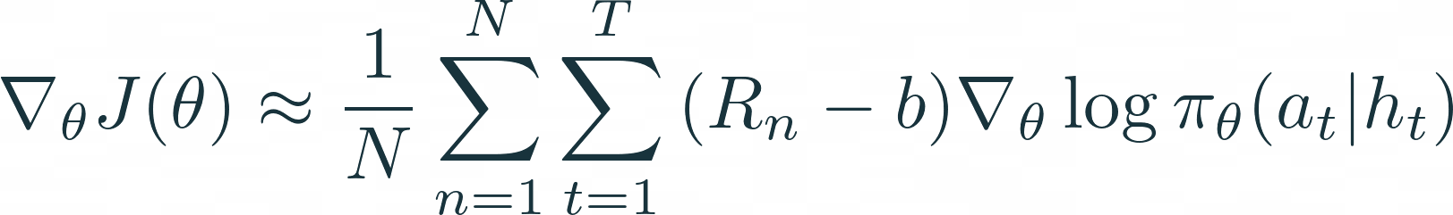
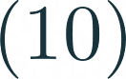
Training with Policy Gradient
Although the gradient in (6) is a good estimate, it may contain high variance which will make the network hard to converge.
=> A common countermeasure is to subtract the reward by a constant baseline b, so the gradient becomes:
Note:
b is computed as the moving average of rewards experienced so far for computational efficiency.

Slide 32


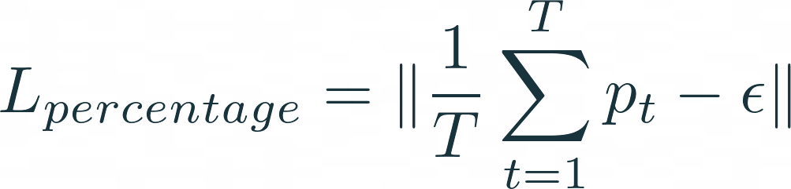
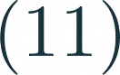

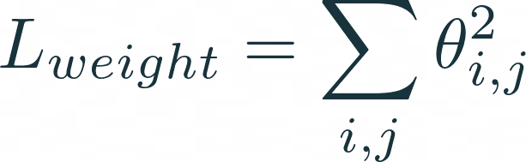
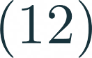
Regularization
To avoid excessively long summaries, a penalty term (L_percentage) is imposed on the probability distribution cccc . This term discourages the DSN from selecting too high a percentage of frames in the video summary.
The L_ regularization term is also added on the weight parameters to avoid overfitting.

Slide 33
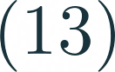



Optimization
The policy function's parameters is updated via the stochastic gradient-based method.
Note:
at : learning rate.
Ht and ccc are the parameters that balance the weighting.
In practice, Adam is used as the optimization algorithm.

Slide 34
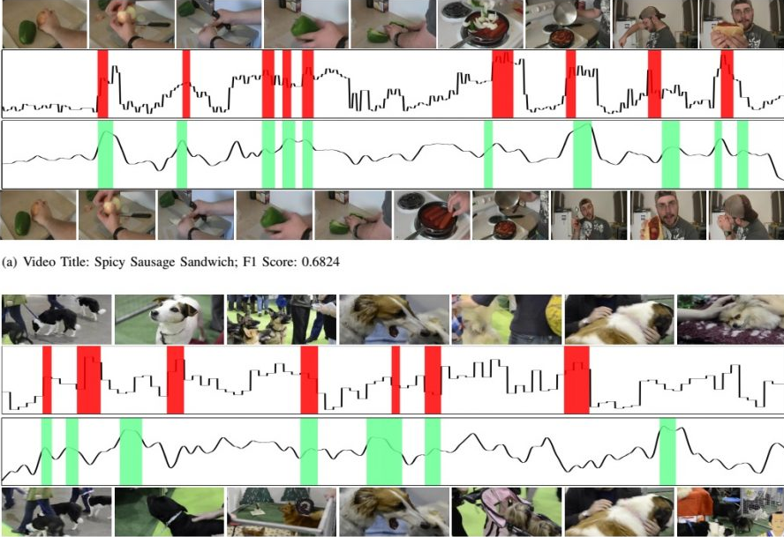
03
Experiment
Summarizing video

Slide 35
Experiment results
Datasets: eccv16_dataset_summe_google_pool5.h5
train videos 20.
test videos 5
Training: 120 epochs.
Testing:
Average F-score 46.0%
No. Video F-score
1 video_11 60.2%
2 video_18 67.5%
3 video_21 23.7%
4 video_22 41.2%
5 video_9 37.2%

Slide 36
04
Demo
Summarizing video

Slide 37
Thank for listening!
Do you have any questions?

